Slide 1
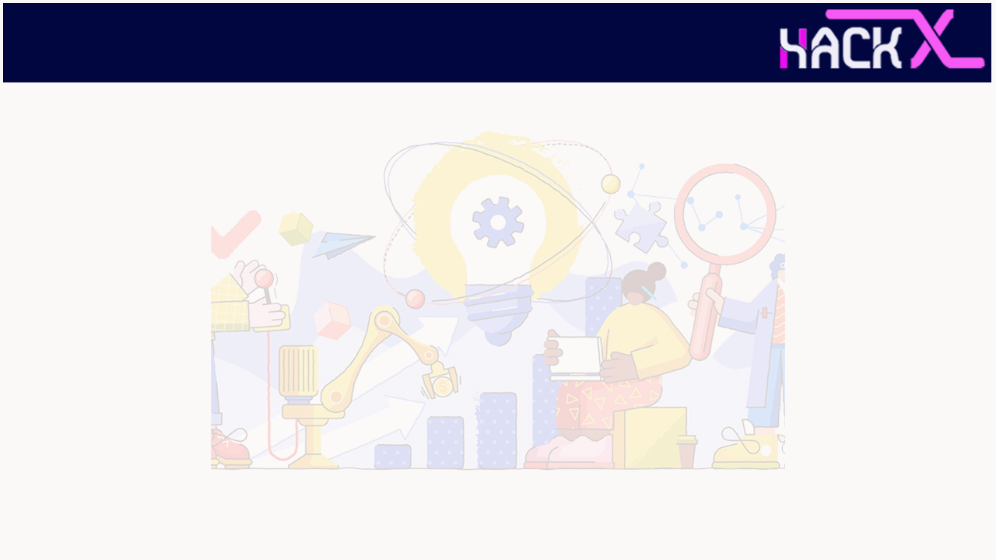
SLIDE 1
Team Name - DALCV_CODE_WITH_US
2. Members Name and Phone Numbers
Sreeram Divya Sri(Leader) * ph.no: 9150466889
Nerella Sai ph.no: 9390083836
A.Sai Charish ph.no: 7386347481
Vara Lakshmi Yimani ph.no: 6309807747
K.Lahari ph.no: 6304918170
3. Domain name - OPEN INNOVATION

Slide 2
SLIDE 2
PROBLEM STATEMENT
Maximum number of farmers are uneducated . They are not aware of agricultural technologies. They are still using traditional practices . They are travelling long distances just to get to know about their soil fertility , crop problems, to get good fertilizers, pesticides. And so many are facing weather related problems. Regulation of water in their agricultural lands on time basis and they are facing difficulties to sell their crop at their desired prices, farmers are facing difficulties in calculating profit loss .and some novice farmers find difficulties to farm
After some period, when farmers find no crops to be grown they can use crop rotation technique and some plants require more fertility for their growth while others require less. So we included crop rotation methodology through which farmer can gain knowledge on this .to know more or get practical knowledge, farmers can see youtube videos which will be included in the website. This pandemic situation has affected all domain people and there was a huge economic loss.It affected farmers all over the world. So through this website ,we are providing future pandemic prediction technology using artificial intelligence

Slide 3
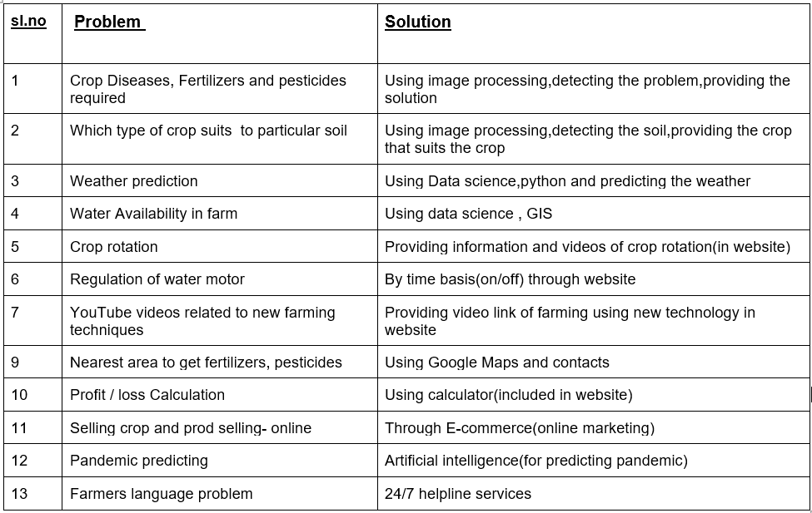
SLIDE 3
soil
,Water resource management

Slide 4
SLIDE 4
ABSTRACT
Nowadays most of the farmers face many problems like they don’t know which crop to use and choosing the right crop at the right time and as the technology is developing day by day we can predict the weather but most farmers don’t know what to use and how to predict, by considering all these problems our team came up with some ideas. By taking image of crop one can identify disease of crop and get the fertilizer, pesticides,and the farmer also can record the disease of the crop that he can see and send it in the website to concerned one, Farmer’s discussion (discussion forum)-if one faces a problem and uploads the pic, if some other also faces the same problem, they can advice the other farmer. And By taking images of land we can predict which crop suits a particular soil. We can also predict the Water availability in their locality or farms. To regulate the water supply(motor on/off by fixing time).Farmers can sell their product online at their desired rates through tie up with companies directly instead of intermediaries farmers can calculate their own profit and loss. This pandemic situation has affected all domain people and there was a huge economic loss. Through this website one can come to know about the pandemic situations, and through this ,they can regulate their crop production

Slide 5
SLIDE 5
NOVELTY
Generally, farmers cannot detect most of the diseases of their crops, so using our website(by image processing) farmers can take an image of their crop and upload it and come to know what problem the crop is having and use the particular pesticides and insecticides. We can also detect which crop suits the particular soil .Some Farmers are unaware of Crop rotation, so through this website, farmers can get complete knowledge of crop rotation and farming techniques. Farmers can sell their crops online at their desired rates to corporate companies without brokerage. 24/7 Helpline services are also provided. This website provides complete statistics of soil, weather, water available, and pesticides to be used for the crops. Other websites mostly do not contain all the above features. But we have identified major problems facing by the farmers and we have provided solutions to those problems. Thus our website stands out from other existing websites.

Slide 6
SLIDE 6
TECHNOLOGY STACK
Image processing,
Data science,
Web development
Artificial intelligence,
GIS

Slide 7
SLIDE 7
HARDWARE / SOFTWARE IMPLEMENTATION
Database
web development (vs code)
pycharm(python)
jupyter notebook
Notepad++
matlab
Processor: Minimum 1 GHz; Recommended 2GHz or more.
Ethernet connection (LAN) OR a wireless adapter (Wi-Fi)
Hard Drive: Minimum 32 GB; Recommended 64 GB or more.
Memory (RAM): Minimum 1 GB; Recommended 4 GB or above.
Windows 10, 64 bits.
CPU quad-core or hexa-core Intel i9/Threadripper/Ryzen 9/.
GeForce GTX GPU compatible with OpenGL 3.2 and 2 GB RAM.
Hard disk: SSD.
between 100 and 500 images at 14 MP): 16GB RAM, 30 GB SSD Free Space.

Slide 8
SLIDE 8
BUSINESS SCOPE
Nowadays most of the farmers have smart phones with them. In 3-4 years at least 90% of the farmers will be having smartphones. So there's a huge scope for learning farming and solving major problems faced by farmers through this website. Farmers can use this website for free. They can also communicate with the concerned authorities using help lines in their regional language.
Novice farmers can also learn farming from this website. As There will be wide usage of this website in a few years,There is a huge scope for this website in the market.

